Slide 1

Analyzing Time Sheets
Label Energy Corp
Does an unlimited vacation policy improve productivity?
Author: Kurt Stoneburner
DSC 530, Fall 2020. Bellevue University

Slide 2


Privacy and Anonymity
The analysis in this report is based on actual time sheet data from an energy consulting company. Due to privacy and intellectual property concerns I've assigned the energy company the moniker of Label Energy Corp. My partner is the office manager for Label Energy Corp and has a real need to analyze time sheet data for insights.
Customers are represented in terms of the distribution of unique clients. The diversity and distribution of clients is important, not the actual clients themselves.

Slide 3

Label Energy Corp
"We are a leading energy consulting firm specializing in building energy analysis and California Title 24 Energy Code Compliance"
California based energy consulting firm:
Evaluate title 24 (energy code) compliance for structures requiring a building permit.
Consult with large electricity providers energy code compliance
Educate architects and county permitting departments on best practices and proper title 24 (energy code) compliance.

Slide 4

The Label Energy Corp Data
A consulting company operates by billing customers for an employee's time for an assigned task.
Both hourly and salary employees must account for the time spent on every task performed throughout the day.
Each employee records their activities using time tracking software.
This software generated an excel spreadsheet containing each employee's tracked time in 2019.

Slide 5
Data: Wrangling, Cleaning, Anonymizing
Anonymizing – Employee names were replaced with generic employee designations (EMP_1, EMP_2...EMP_12)
Wrangling – Timesheets were provided as 12 separate excel files (one for each employee). All timesheets were combined into a single PANDAS DataFrame. Anonymized employee designators were added to keep track of individual employee time.
Cleaning – The data was fairly clean in its raw form.
'has_flags', 'flag_types' were removed.
The date column was converted to a standardized date format.
A salary column was added to indicate whether an employee was salary or hourly.
Additionally, a 'day_int' column was engineered to convert the day of the week into an integer 0-6 (Monday-Sunday).

Slide 6


Statistical Questions:
Label Energy Corp has an unlimited vacation policy for its salaried employees.
I was specifically asked by the Office Manager:
"How does an unlimited vacation policy effect the [productivity of] salary employees?"
I was personally curious about:
"Does Label Energy Corp too dependent on a single high profile customer?"

Slide 7

Time Sheet Variables
Date – The date in Year-Month-Day Format.
Hours – Total Hours per task
Jobcode_1 – Indicates the billable customer task which could be an external company, internal overhead hours, or time off.
Jobcode_2 – Specific customer billable task descriptions.
Activity – Additional Task coding information
Billable – Indicates if task requires a separate invoice.
Class – Job department code. Reflects the different work areas of the company
Service Item – Additional service explanation for the customer. Reflects the type of work from consulting
Activities – Indicates progress in a particular activity
Emp_name – Anonymized employee names. Employee names have been replaced with a standardized moniker: EMP_1, EMP_2 … EMP_12
Day_int – (Engineered variable) Represents the day of the week as an integer from 0-6 (Monday – Sunday)
Day - (Engineered variable) The day of the as a name (eq. Monday, Tuesday,...Sunday)

Slide 8
Engineered Variables
Hours is the only variable that is quantitative. The rest of the variables are categorical. To address the statistical questions, several variables will have to be created.
Salary/Hours – Total hours by a salary employee
Hourly/Hours – Total hours by an hourly employee
Billable/Hours – Hours allocated to directly billing the client. These hours represent the primary source of income for Label Energy Corp.
Overhead/Hours - Hours allocated to non-billable tasks. This is work the company isn't directly compensated for.
Productive/Hours - Billable + Overhead hours. This is the general measure of an employee's effectiveness.
Billable/Hours per Client – Total billable hours for each client. Used to quantify customer diversity.

Slide 9
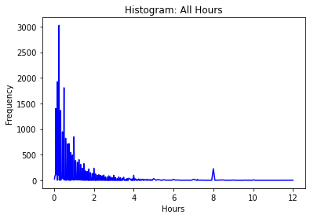
The distribution of all logged tasks hours indicates that tasks lengths skew heavily towards tasks that are less than hour. Indicating workers shifting between numerous tasks throughout the day. Excessively long tasks (>4 hours) are rare.
The 8 hour spike indicates logged vacation time
Total Task Hours
Distribution:
All Tasks by Hours
Mean: .9627
Median: .5
Mode: 0.25 (3025 of 23018)

Slide 10

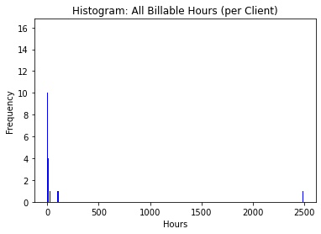
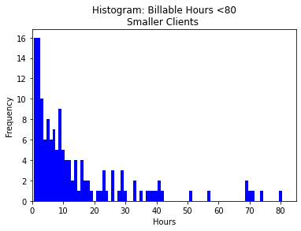
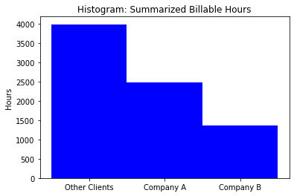
Distribution: Client Hours
Uneven client hour distribution – There is a significant disparity in billable hours per client. Label Energy's top clients billed 2484 and 1369 hours. The third highest billed client was 372 hours.
Client Diversity – There is a significant portion of billable hours dedicated to a diversity of clients with many customers requiring less than 30 hours of billable work.
Total Billable Hours: 7838.17
Company A Hours: 31.7%
Company B Hours: 17.5%
Other Hours: 51%

Slide 11

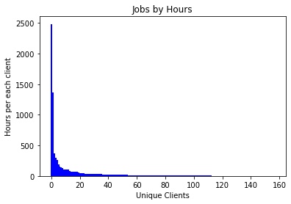
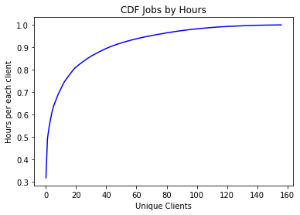
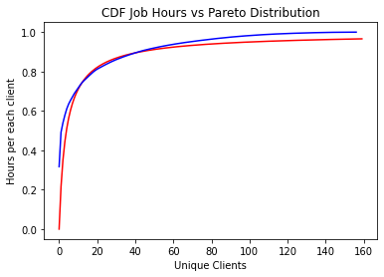
Distributions:
Hours by Unique Clients
The distribution of hours per unique clients further demonstrates the outsized dominance of just two clients for Label Energy Corp.
A cumulative distribution function is another to way to show that 50% of hours fall are dedicated to two clients.
80% of total billable hours are allocated to 12.5% (20) clients.
The unique client hours distribution is pretty close to a Pareto distribution with a of Shape .85 and Scale 3.

Slide 12
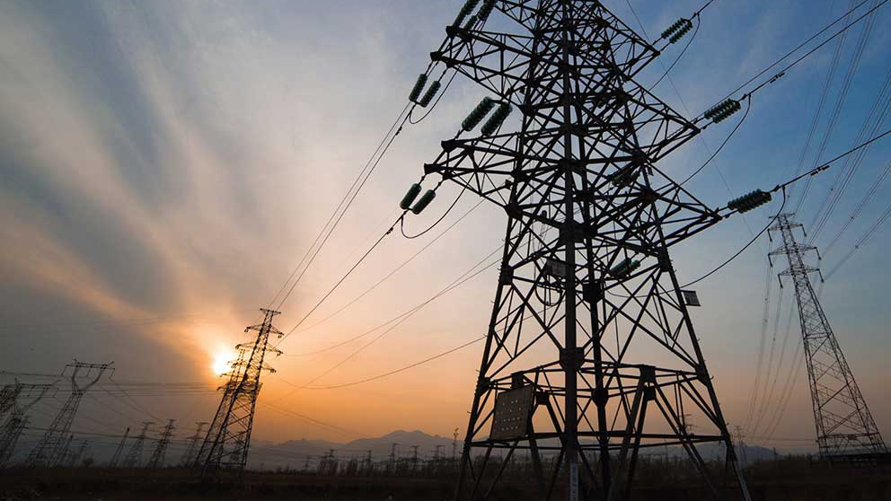
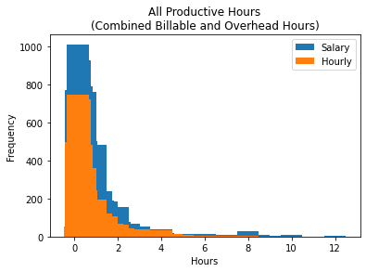
Distributions: Worker Productive Hours
Salary vs Hourly
Salary workers clearly work more total hours than hourly employees. There are differences in scale to consider.
Hourly employees are generally constrained to an 8 hour work day. Hourly employees may not work a full 8 hour day, since they are paid per hour.
Salary workers do not have fixed work hour limits.
Salary compensation closely correlated with billable hours.
Salary workers are incentivized to work more hours in general.

Slide 13

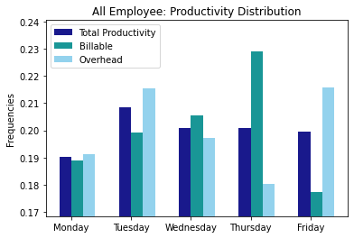
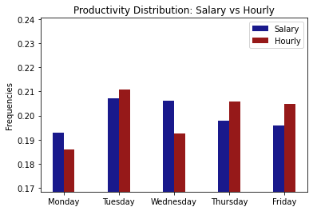
Productivity by Day of the Week
Probability mass functions display how hours are distributed throughout the week.
The productivity distribution indicates there is a difference in work output based on the day of the week. Overall Monday has the fewest productive hours, while Tuesday has the most. Wednesday – Friday are relative even.
The billable hours increase each day through Thursday, and dramatically fall off on Friday which has the highest overhead hours. It's likely the push on Thursday's is so clients can file permits on Friday, before the weekend.
Salary employees tend to be more productive on Tuesday's and Wednesdays. While hourly employees are notably more productive on Tuesdays, Thursdays, and Fridays.

Slide 14

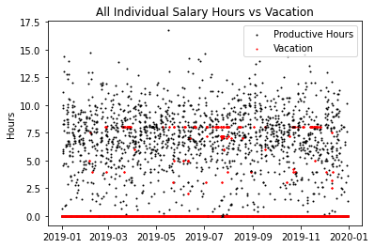
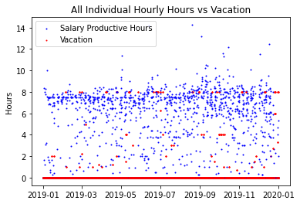
Time Series: Hours vs Vacation
These plots show all employee hours distributed across the year. Each day includes 6 data points representing the 6 salary and 6 hourly employees. The red dots indicate vacation.
Salary hours worked is somewhat randomly distributed. Work hours tend to be clustered around 6 – 10 hours. However there is wide range of variability in work output. This indicates very flexible work hours.
Hourly employee hours are clustered more around the 8 hour work day. There are a significant portion of work hours that are less than 8. Shorter work days appear to be more prevalent in the third quarter, likely due to the holiday season. The lack of consistent hours is indicative of a flexible and permissive work environment. The philosophy of flexible work hours appears to apply to both salary and hourly workers

Slide 15
Time Series:
The Vacation Correlation
There doesn't appear to be strong visible correlation between vacation and productivity. The correlation between vacation and productivity varies by employee.
Correlation: Hours vs Vacation
Salary Employees
EMP_1 : -0.33
EMP_2 : -0.27
EMP_6 : -0.09
EMP_8 : -0.34
EMP_11 : -0.28
EMP_12 : -0.18
==============
Mean : -0.25
Hourly Employees
EMP_3 : -0.29
EMP_4 : -0.13 EMP_5 : -0.11 EMP_7 : -0.28 EMP_9 : -0.04
EMP_10 : nan ==============
Mean : -0.17
Using a time series to correlate productivity with vacation does not appear to be a good method to capture the relationship between the two. There is a .07 mean correlation difference indicating unlimited vacation may have an effect on productivity

Slide 16
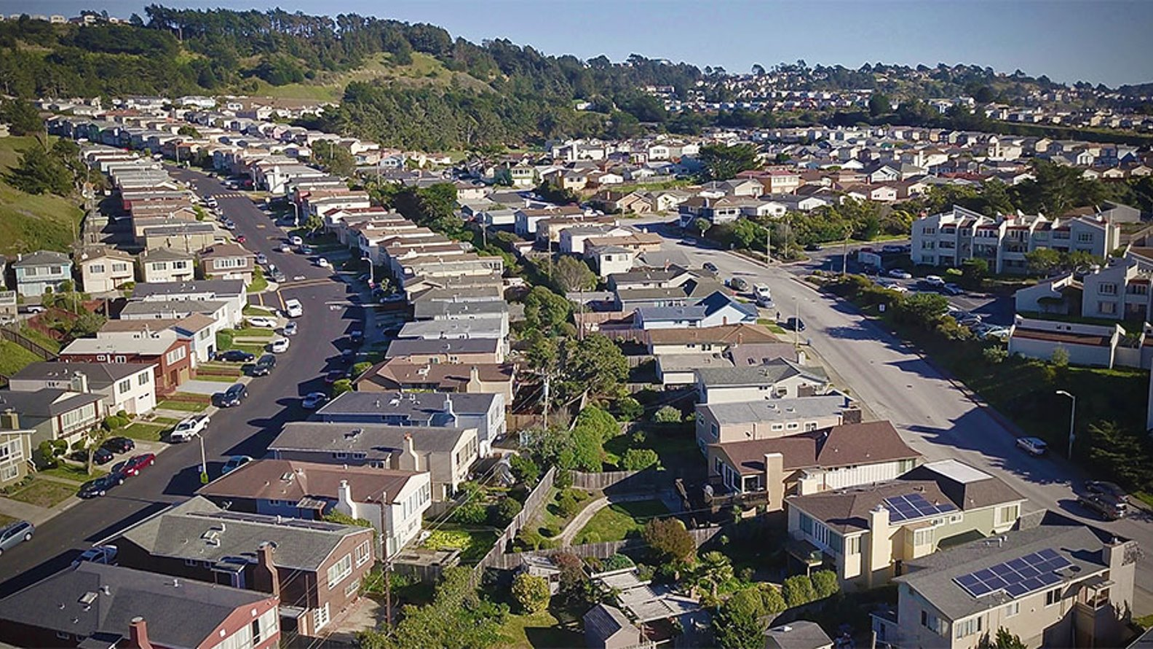
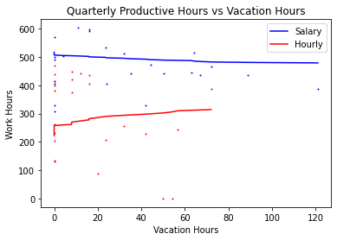
Regression:
Quarterly Hours vs Vacation
To better capture the relationship between productivity and vacation, each employees hours were summed for each quarter of the year.
This graph portrays employee quarterly productivity vs quarterly vacation. Since each employee is more likely to take some time off during any given quarter, the relationship between productive and hours becomes clearer.
Salary
Total Hours
Productive: 11132.5 Vacation: 774.5
Mean Hours
Productive: 1855.42 Vacation: 129.08
Correlation: -0.66
Hourly
Total Hours
Productive: 6999.9 Vacation: 418.3
Mean Hours
Productive: 1166.66 Vacation: 69.72
Correlation: 0.60

Slide 17
Regression: Analysis
Regression modeling quarterly hours demonstrates two different effects of vacation on productivity.
Salaried employess have a small negative coefficient. As vacation increases, there is a slight decrease in productivity.
Hourly employees have a strong positive coefficient. As vacation increases, productivity increases.
Salary Regression Model
Intercept: 516.65
Coefficient: -1.64
R²: 0.44
Per employee Intercept
(No Vacation) - 86.11 Hours
(Max Vacation) - 79.84 Hours
Hourly Regression Model
Intercept: 221.62
Coefficient: 4.02
R²: 0.37
Per employee Intercept
(No Vacation) - 36.94 Hours
(Max Vacation) - 52.34 Hours
Accounting for salary vacation on an average per employee basis, the estimated productivity cost for maximum quarterly vacation is 6.27 (86.11-79.84) hours per employee quarter or 25.08 hours per employee per year. Which represents an average productivity cost of 1.35%.
Hourly employee vacation has a measurable positive effect on productivity. At maximum vacation, the productivity of the average hourly employee improves by 15.4 hours, per employee quarter or 61.4 hours per employee year. This represents a productivity gain of 5.2%.

Slide 18
Regression: Hypothesis testing
The null hypothesis is that there is no correlation between quarterly vacation hours and quarterly productivity hours.
The null hypothesis can be tested by randomly resampling the data and correlating the random results.
The null hypothesis was sampled against 10,000 random iterations.
Salary Productivity p-Value = 0.0007 Hourly Productivity p-Value = 0.0026
The p values indicate the, correlation between quarterly productivity hours and quarterly vacation hours is significant.

Slide 19

Conclusions: Vacation Incentives Vary
Hourly employees
Vacation increases productivity
1 Vacation/Hour (per Quarter) = 4 Productive/Hours (per Quarter)
Effect is likely due to the type of work performed and consistency of hours worked throughout the day.
The model suggests there may be a benefit to increasing vacation allotments to hourly employees.
Salary employees
Vacation decreases productivity
1 Vacation/Hour (per Quarter) = -1.64 Productive/Hours (per Quarter)
Effect is likely due to salary workers consistently working more hours per day (per Quarter) than hourly employees.
Compared to the overall productivity the effect (cost) of vacation is minor.
Work hard! Salary employees are 62% more productive than their hourly counterparts. The cost of unlimited vacation is 1.35% productivity which is negligible compared to increased productivity.

